Slide 1
The Document Object Model (DOM)
An introduction to the concept
Notes:
Presentation by Mindy McAdams, February 2013. ------ CONTACT ----- http://mindymcadams.com/

Slide 2
If you search around the Web, you’ll find a lot of representations of the DOM. Not all of these are accurate.
Notes:
This is illustrated by the following images.

Slide 3
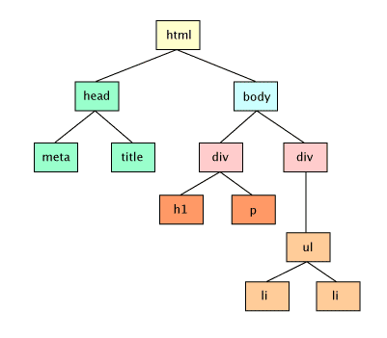
http://finearts.fontbonne.edu/tech/web/script/js_DOM.html
Notes:
This diagram places HTML at the top of the DOM. http://finearts.fontbonne.edu/tech/web/script/js_DOM.html

Slide 4
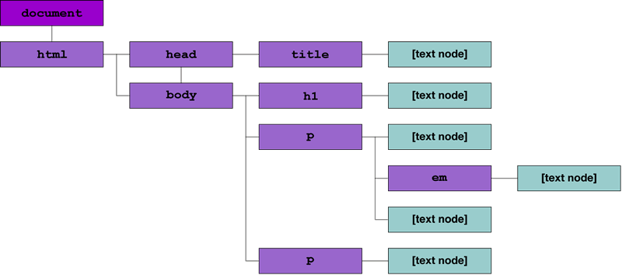
http://dev.opera.com/articles/view/traversing-the-dom/
Notes:
This diagram places DOCUMENT at the top of the DOM. http://dev.opera.com/articles/view/traversing-the-dom/

Slide 5
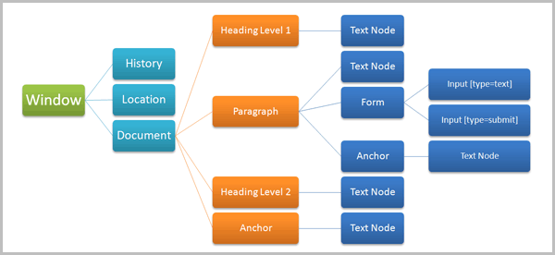
http://net.tutsplus.com/tutorials/javascript-ajax/javascript-and-the-dom-series-lesson-1/
Notes:
This diagram places WINDOW at the top of the DOM. http://net.tutsplus.com/tutorials/javascript-ajax/javascript-and-the-dom-series-lesson-1/

Slide 6
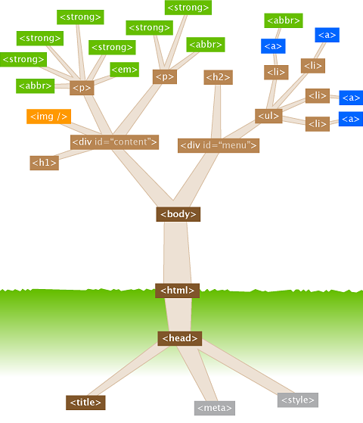
http://107.22.190.18/deadball/archives/13
Notes:
This diagram places HTML in the center, which is odd – but I like the upper branches. http://107.22.190.18/deadball/archives/13

Slide 7
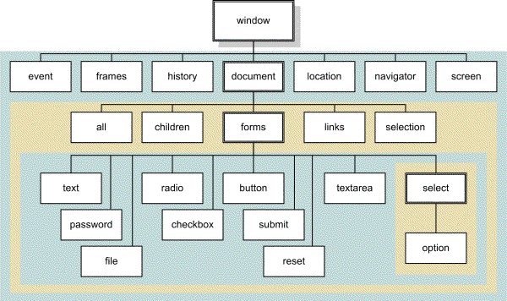
http://elvex.ugr.es/decsai/internet/web/javascript.html
Notes:
This diagram places WINDOW at the top of the DOM. http://elvex.ugr.es/decsai/internet/web/javascript.html

Slide 8
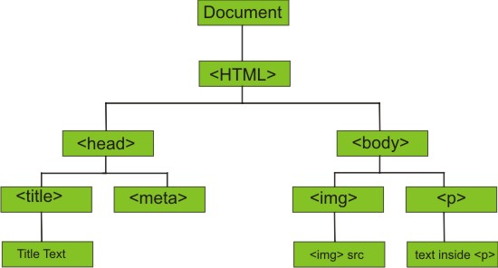
http://coderbay.com/exploring-htm-document-object-model-dom/
Notes:
This diagram places DOCUMENT at the top of the DOM. http://coderbay.com/exploring-htm-document-object-model-dom/

Slide 9
“The Document Object Model is a platform- and language-neutral interface that will allow programs and scripts to dynamically access and update the content, structure and style of documents. The document can be further processed and the results of that processing can be incorporated back into the presented page.”
—World Wide Web Consortium (W3C)
Notes:
W3C - World Wide Web Consortium (2005) “The Document Object Model Activity is closed. The Document Object Model Working Group was closed in the Spring of 2004, after the completion of the DOM Level 3 Recommendations. “
http://www.w3.org/DOM/

Slide 10
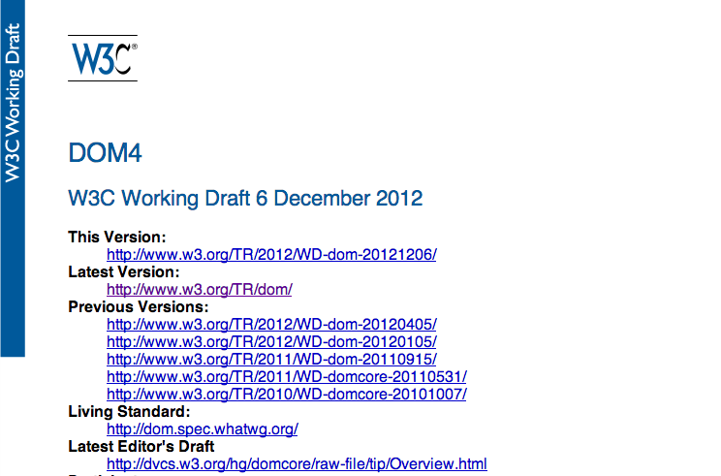
The definitive source: http://www.w3.org/TR/dom/
Notes:
http://www.w3.org/TR/dom/

Slide 11
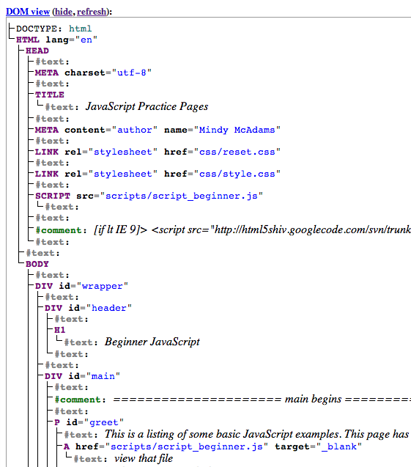
If you example the source of any HTML page in the W3C’s recommended “Live DOM Viewer,” you can easily see the “tree.” This illustrates the actual DOM of a real document.
Notes:
http://software.hixie.ch/utilities/js/live-dom-viewer/

Slide 12
“A tree of nodes”
A document is represented as a tree of nodes of various types.
Many nodes have “child” nodes (and any child has a direct “parent”).
A child is a node. Any node may have “children.”
The “sibling” of a node is a node that is on the same level or line, neither above it or below it.
—World Wide Web Consortium (W3C)
Notes:
http://www.w3.org/TR/dom/

Slide 13
An idea to understand
<div>
<p>This is a <em>new</em> paragraph in an HTML document.</p>
</div>
The <p> is a child of the <div>
The <em> is a child of the <p>

Slide 14
A good introduction and explanation of the DOM: W3C DOM – Introduction http://www.quirksmode.org/dom/intro.html
Notes:
http://www.quirksmode.org/dom/intro.html

Slide 15
The Document Object Model (DOM)
Presentation by Mindy McAdams
[February 2013]
Notes:
Presentation by Mindy McAdams, February 2013. ------ CONTACT ----- http://mindymcadams.com/

